Slide 1

ANALYZING CONSUMER'S PURCHASING INTENTIONS DURING ONLINE SHOPPING
Why analyze consumer’s behaviors during online shopping?
Key Objectives
Exploratory Data Analysis
Visualization
Correlation Analysis
Preparing the Dataset
Modelling
Conclusion
Presented by: Manvi Bajpai
Notes:
Photo by power point stock photo

Slide 2

Why analyze consumer’s behavior during online shopping ?
One of these aspects is making real-time predictions about online shoppers' intentions and offering them promotions if it appears that they are about to leave the website.
An essential indicator of how successful the company's website and digital strategy are is the purchase conversion rate.
For e-commerce businesses to analyze and develop improvement plans, understanding consumer engagement rates through login, exit timings, clickbait's, and traffic pages is a useful tool.
Consumers' increased use of online purchasing is an intrusive topic for data scientists, analysts, and businesses to investigate and personalize the online experience for users.
The concept can be widely use by small business and a valid model can be formulated for these business owners to manage their store pages

Slide 3
Key Objectives
To understand the analytical techniques used by companies to analyze consumer’s engagement and pattern to improve revenue/profit generation
Project Description
Step I :Examining customer behavior during a visit and how it affects the business in accordance with the dataset.
Step II: Predicting a machine learning model employing different methodologies to determine precise future values on customer online shopping intentions.
Project Findings
Data Source
Dataset: http://archive.ics.uci.edu/ml/datasets/Online+Shoppers+Purchasing+Intention+Dataset
The dataset has been downloaded from the UCI Machine Learning Repository. It is to be noted that the available dataset is a subset of the original data as found in the research paper. https://doi.org/10.1007/s00521-018-3523-0
Data Set
Classification Models: Logistic Regression, Random Forest, SVM, KNN Classifiers and Naïve Bayes' Theorem
Modelling Methods

Slide 4

Exploratory Data Analysis ( EDA )
No missing values
Duplicate values = 125
Target variable = Revenue ( given in the dataset)
No.of observations = 12330
Dtype was changed for revenue from boolean to binary values
Using Pandas Profiling
The exploratory data analysis for the dataset can be referred from the link attached below:
Pandas Profiling Report
Consists of Categorical Variables along with numerical variables hence Classification Machine Learning Models will be used
The presence of outliers was adjusted as explored that the prsence could be neglected as the independent variables show negligeble to no effect caused by them

Slide 5
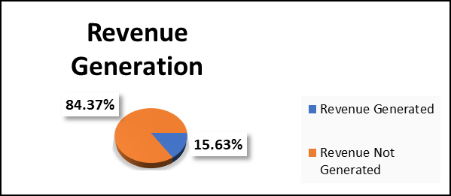
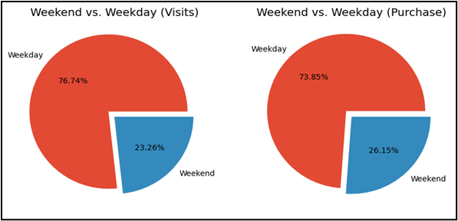
OBSERVATIONS:
For the given year in accordance to the data the revenue generation performance is disappointing where only around 15.47% of revenue was accounted in comparison to 84.52% with no revenue generation.
With respect to the weekend and weekday visit of the consumer we can see the illusion of buying more on weekends had been broken with
With respect to weekend and weekday purchasing activities of the consumer once again in transactions were carried out more on weekdays
Around 85.5% are returning visitors showing positive engagement of consumers.
Around 13.73% are new visitors showing lack of effective marketing strategies.
Visualisation of univariate and bivariate analysis

Slide 6
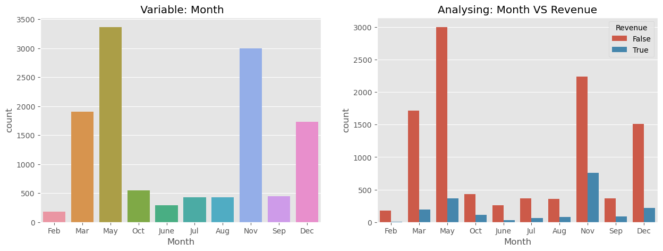
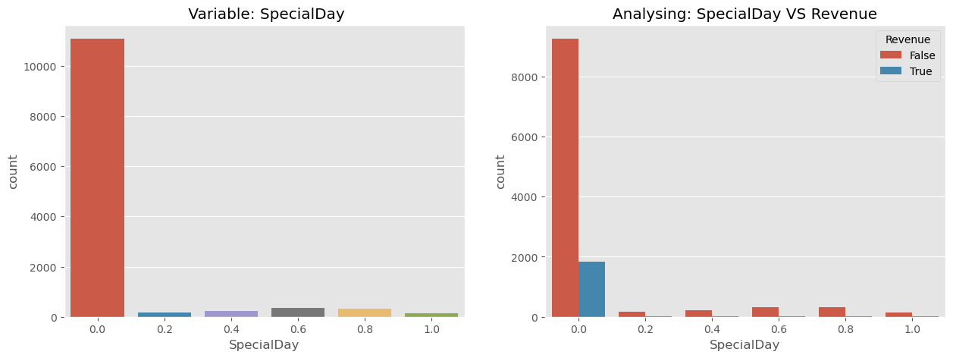
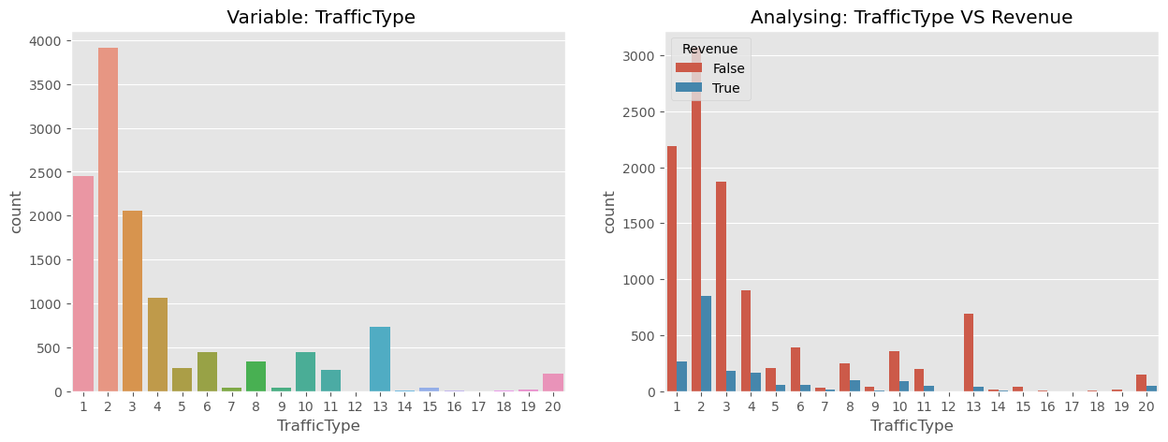
OBSERVATIONS:
Maximum Visitors: March, May, November and December
Maximum Revenue generation: November ( then May)
Minimum Revenue generation: February
89.8% of revenue generation happened on Non-Special Days, hence no special engagement or revenue was seen.
Maximum Traffic Generated = Types 1, 2, 3, 4, and 13
Compared to other traffic categories, Traffic Type 2 has generally made a bigger contribution to revenue production.
Zero Traffic Generated = Types 12, 15, 17, and 18
Visualisation of univariate and bivariate analysis

Slide 7
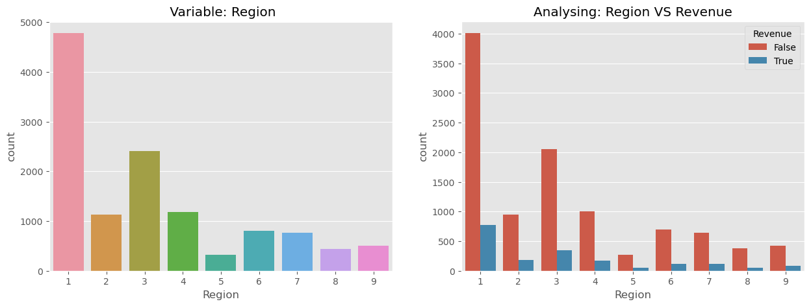
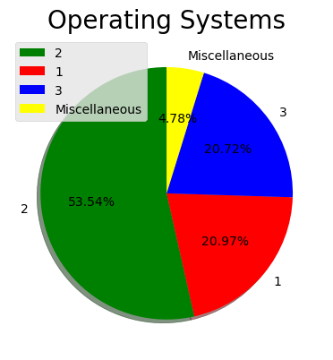
OBSERVATIONS:
Maximum visitors from Region 1,2, 3, 4 & Maximum revenue generation: Region 1 and 3.
Minimum visitors from Region 5, 8, 9. & Minimum revenue generation: Region 5 and 8.
Top 3 Operating System (OS) are
OS: 2 with 53.4% ,
then OS: 1 with 20.97 and
OS: 3 with 20.72% performances and miscellaneous OS needs to be looked into for improved performances by the company.
Visualisation of univariate and bivariate analysis

Slide 8
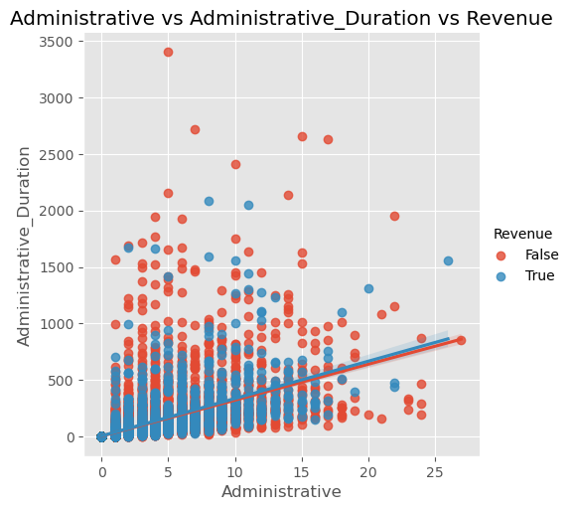
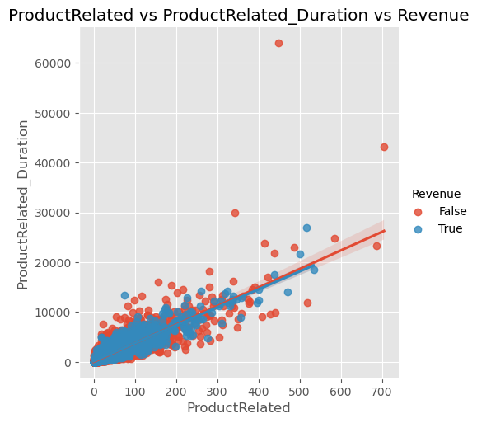
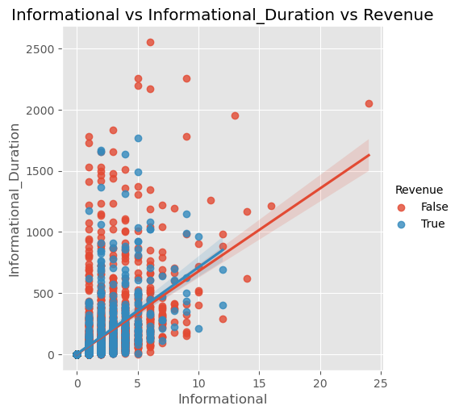
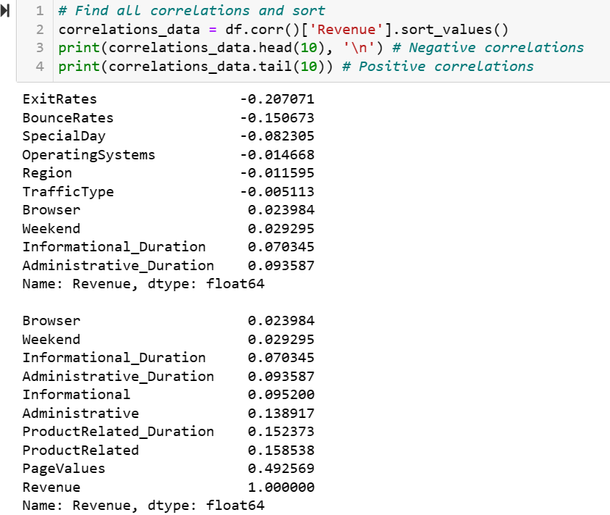
CORRELATION ANALYSIS
OBSERVATIONS:
Here we can observe that Administrative Pages and Administrative Duration, Informational and Informational Duration, Product Related and Product Related Duration are positively correlated.
Even though customers/visitors have spent a large amount of time on product related pages but the revenue generation is very low.

Slide 9
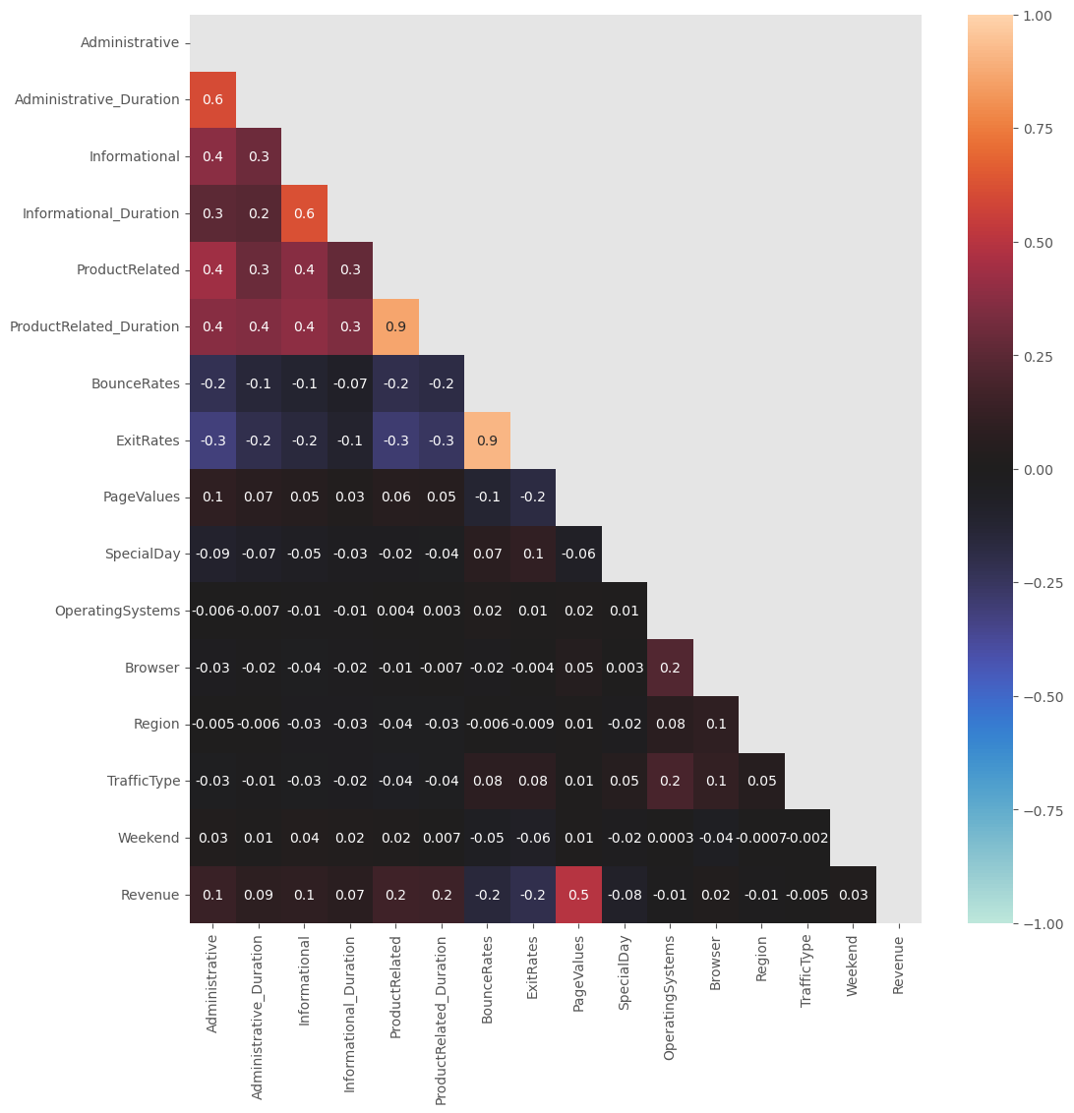
CORRELATION ANALYSIS: Heat Map
OBSERVATIONS:
There is very little correlation among the different features in our dataset.
1. High correlation (|corr| >= 0.7) are: BounceRates & ExitRates (0.9),ProductRelated & ProductRelated_Duration (0.9).
2. Moderate Correlations (0.3 < |corr| < 0.7): Administrative, Administrative_Duration, Informational, Informational_Duration, ProductRelated, and ProductRelated_Duration & PageValues and Revenue.

Slide 10
PREPARATION AND SPLITTING OF THE DATA SET
The preparation of the model starts from the following commands:
dff = pd.concat([df,pd.get_dummies(df['Month'], prefix='Month')], axis=1).drop(['Month'],axis=1)
dff = pd.concat([dff,pd.get_dummies(dff['VisitorType'], prefix='VisitorType')], axis=1).drop(['VisitorType'],axis=1)
print(dff.info())
Splitting the data:
y = dff['Revenue']
X = dff.drop(['Revenue'], axis=1)
X_train, X_valtest, y_train, y_valtest = train_test_split(X, y, test_size=0.3, random_state=101)
X_val, X_test, y_val, y_test = train_test_split(X_valtest, y_valtest, test_size=0.5, random_state=101)
Scaling the data:
sc_X = StandardScaler()
# Will be useful for feature scaling in future
Xsc_train = sc_X.fit_transform(X_train)
Xsc_val = sc_X.fit_transform(X_val)
Xsc_test = sc_X.fit_transform(X_test)

Slide 11
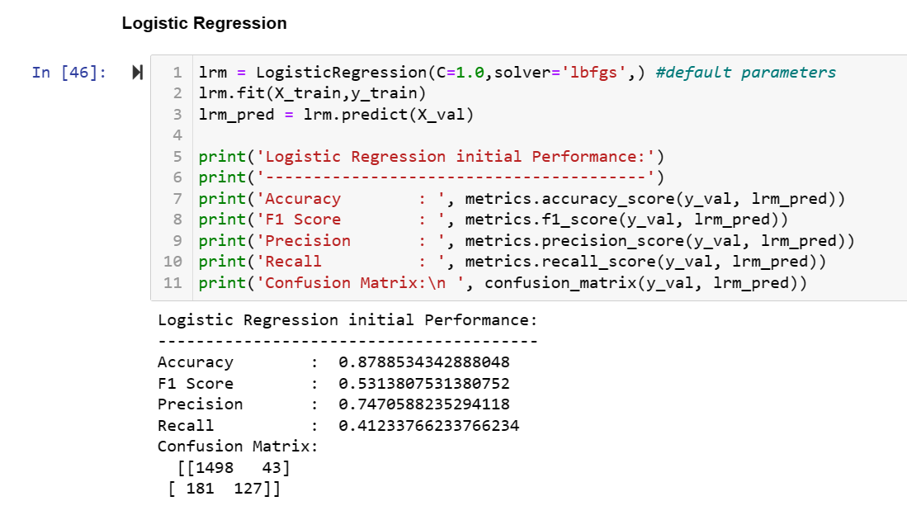
MODELLING: LOGISTIC REGRESSION
Logistic regression measures the relationship between the categorical dependent variable and the independent variables by estimating probabilities using a logistic/sigmoid function.
Confusion Matrix helps in understanding the TP,TN,FP and FN situation.

Slide 12
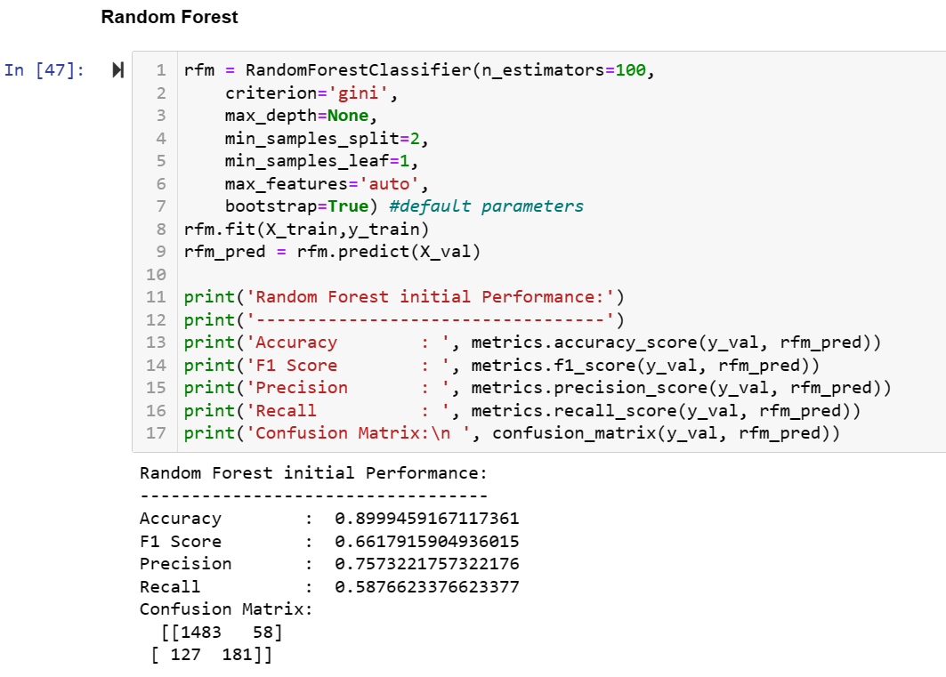
MODELLING: RANDOM FOREST
A random forest is a meta estimator that fits a number of decision tree classifiers on various sub-samples of the dataset and uses averaging to improve the predictive accuracy and control over-fitting.
The sub-sample size is controlled with the max_samples parameter if bootstrap=True (default), otherwise the whole dataset is used to build each tree.

Slide 13
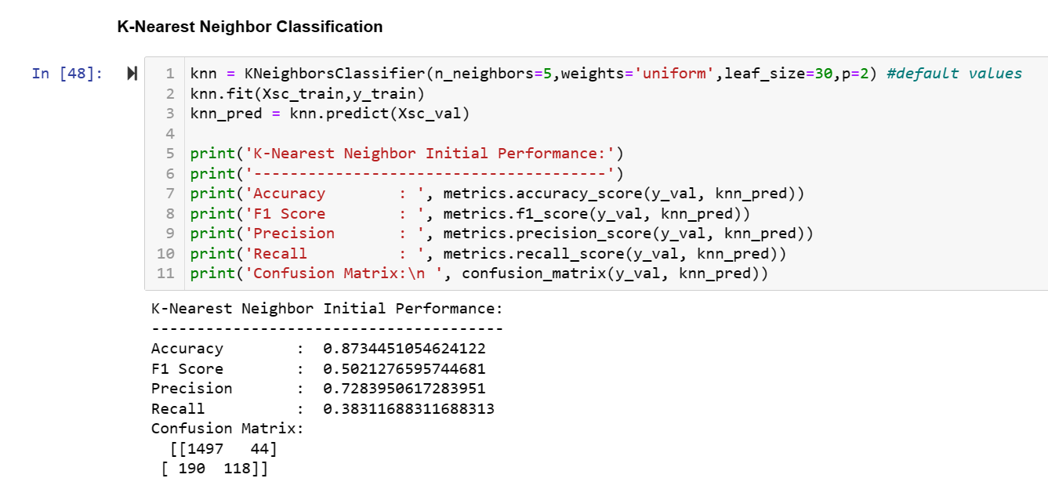
MODELLING: KNN
For K-Nearest Neighbor classifier, we will be using the scaled version of our dataset.
KNN is a non-parametric (no assumption for underlying data distribution) learning algorithm, the model structure determined from the dataset. This will be very helpful in dataset where many features do not follow a specific theoretical assumption.

Slide 14
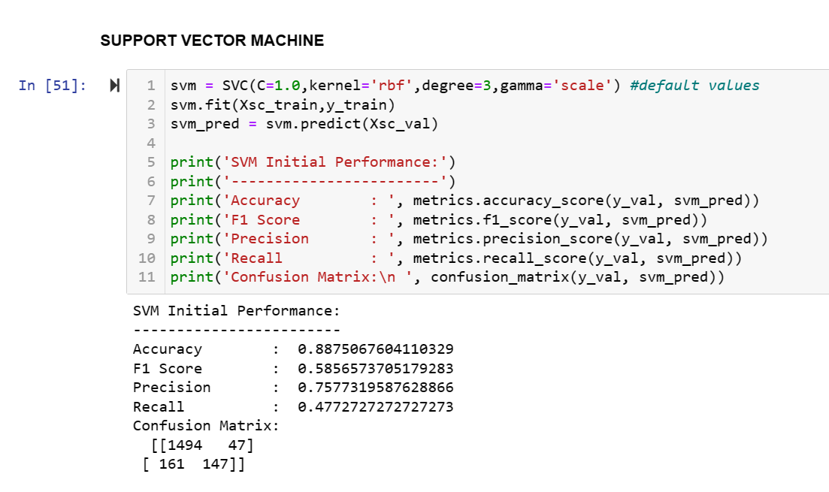
MODELLING: SUPPORT VECTOR MACHINE - SVM
For SVM classifier, we will be using the scaled version of our dataset.
SVM offers high accuracy classification, and it is known for its kernel trick to handle nonlinear input spaces. The classifier separates data points using a hyperplane with the largest amount of margin.
SVM finds an optimal hyperplane which helps in classifying new data points.

Slide 15
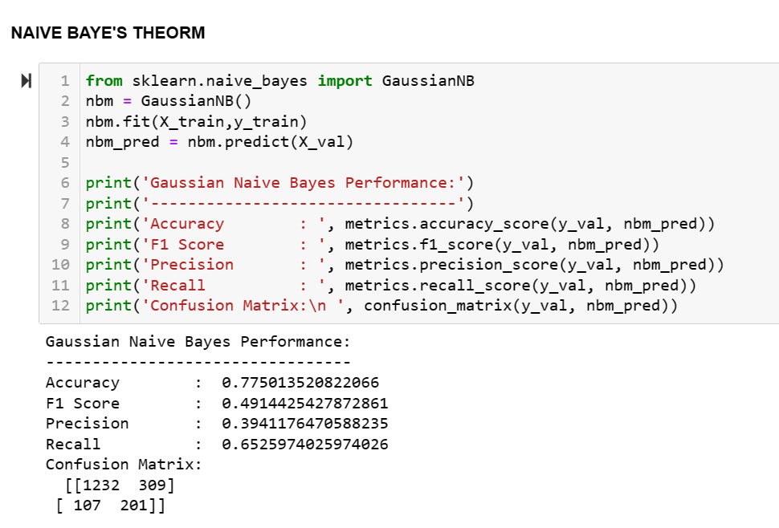
MODELLING: NAÏVE BAYE’S THEOREM
Gaussian Naive Bayes classifier can be used since some of our features are normally distributed, even though other features don't follow a normal distribution.
Naive Bayes result is less than desirable, one reason might be the Gaussian distribution assumption, which for sure does not fit all of the features in our dataset.

Slide 16
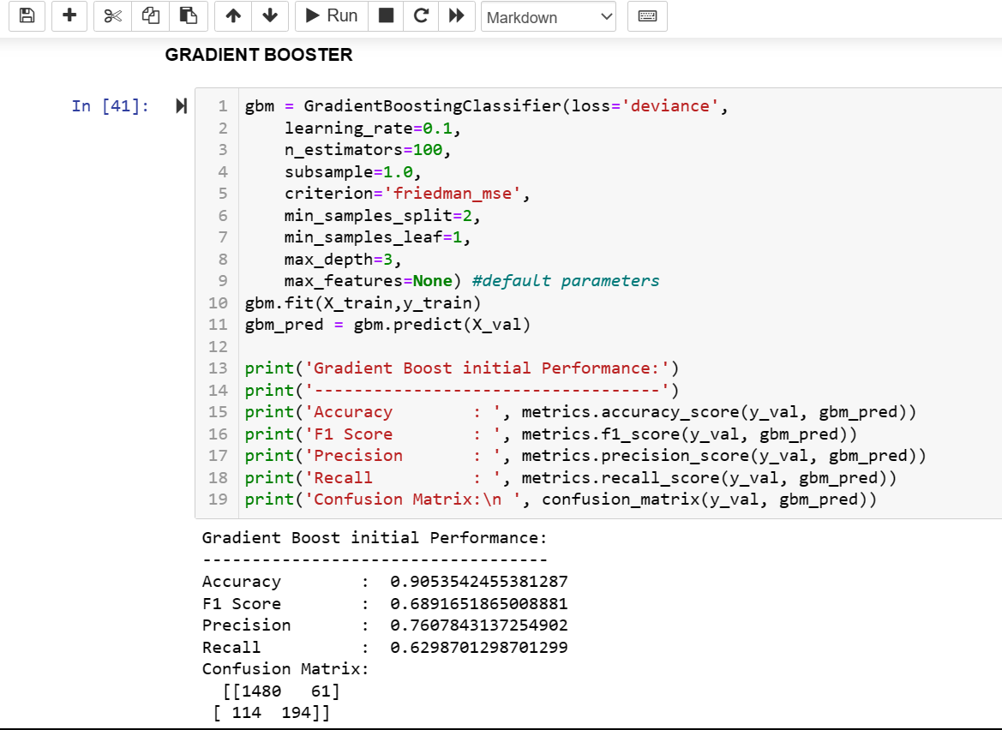
MODELLING: GRADIENT BOOSTER
Gradient Boosted Regression Trees is basically a generalization of boosting to arbitrary differentiable loss functions.
It produces a prediction model in the form of an ensemble of weak prediction models.
Their main advantage lies in the fact that they naturally handle the mixed type data.

Slide 17
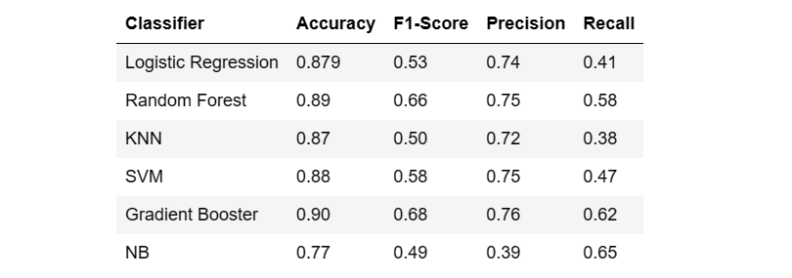
MODELLING DATA: OBSERVATIONS
Observation:
In comparison to SVM, the default logistic regression classifier produced lower accuracy and F1 scores.
The initial SVM model significantly improved all performance indicators when compared to KNN.
In comparison to all other classifiers we have evaluated so far, the random forest classifier (with default parameter values) provides us with a greater accuracy and F1 score.
The default classification performance of gradient boosting is better than that of random forest.

Slide 18
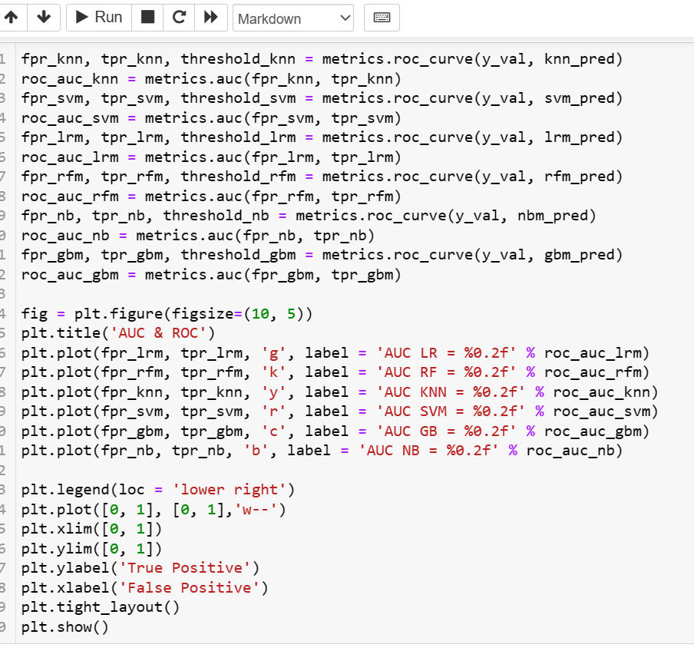
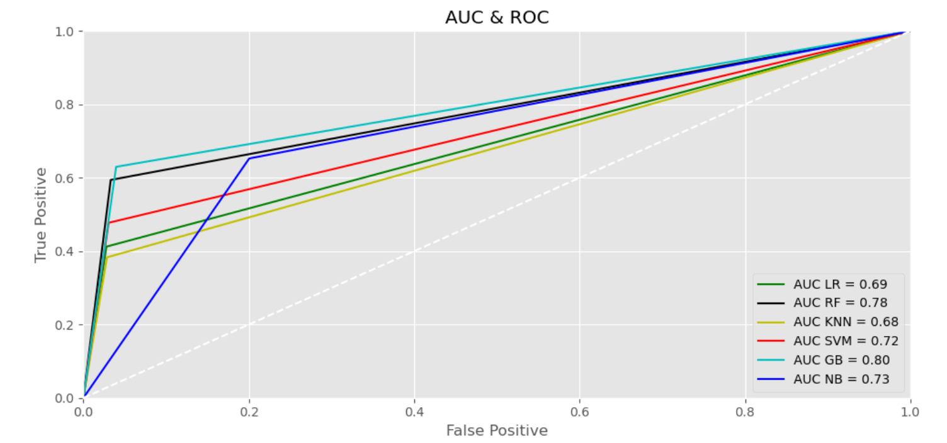
MODELLING: AOC & ROC
Observation:
We can see that from all the above calculated classification metrics shows **Gradient Booster** classifier with the best level of accuracy. Followed by Random Forest and at last Support Vector Machine (SVM) model.

Slide 19
SCOPE OF IMPROVEMENT
In that study, we noticed a lot of factors due to which the desired accuracy of the model wasn’t achieved to it’s fullest .
The problem of extreme outliers for certain variables act as a hindrance in models working but can affect the data's outcome due the variables being large in numbers.
The imbalance of the data set due to non-revenue generation period also lead to models certain level of inaccuracy but can be treated with hyperparameter tuning to better achieve the accuracy of the model.
Working on each variables separately can give much more deeper understanding of the dataset and can yield better models from the sub-problems that might arise when dwelling deep into the data set.

Slide 20
CONCLUSION
In that study, we used the Online Shoppers Intention dataset to create models that can categories website visitors and forecast which of them will probably make a purchase there.
Using random forest, we were able to attain the best classification performance out of 4 different learning classifiers (KNN, SVM, Logistic Regression, and Random Forest).
With real-world data, which can be collected on a monthly, quarterly, or annual basis, one can uncover many more intricate patterns and trends between variables other than those listed in the dataset.
The practical use of these models can help small- and medium-sized business owners understand the value of page visit data and how to use it to enhance customer engagement.
Transaction patterns can help in recommendation and personalized content recommendation and improve the digital marketing scenario.

Slide 21
KEEP SHOPPING AND ANALYZING! THANK YOU
Notes:
Photo by power point stock photo

